Slide 1
Open Soft 2014
Team – 10

Slide 2
Automated Mosaicing of Torn Paper Documents

Slide 3
Abstract
Automated torn paper mosaicing, is a well known problem that arises in the field of investigation science and archival studies. The papers can either be shredded using a machine or manually ripped up. The latter one is often more challenging than the previous one because of complex edge features and introduction of lot of noise. The problem statement required us to approach in a very careful way with precise yet fast collection of important image features, finding the best matches and then properly aligning the images along the matches borders.

Slide 4
Problem Definition
The goal is to seamlessly stitch randomly torn paper documents in an automated fashion. The state of the art can handle up to 50 torn pieces. The challenge is to come up with an innovative algorithm that could potentially handle more pieces, or implement existing algorithms in a faster way. The training dataset would be provided, and the test dataset would be used to evaluate the entries. The training dataset would contain the original document as well as the torn pieces.

Slide 5
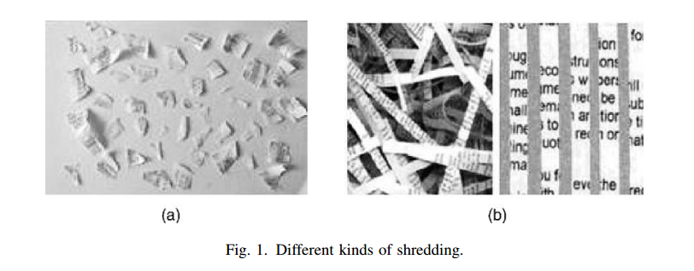
Outline Solution
In case of shredding of papers, each edge has more or less straight edge and hence the problem may be considered as a variety of Jigsaw puzzle. Torn pieces on the other hand have uneven edges bearing undesired shears (containing paper fibres) which give rise to ill-defined physical contours compared to jigsaw puzzle which have smooth and well defined corners. It was therefore necessary to look closer into unique features of each fragmented piece and employ a novel technique for fast and easy reconstruction from several such pieces.

Slide 6
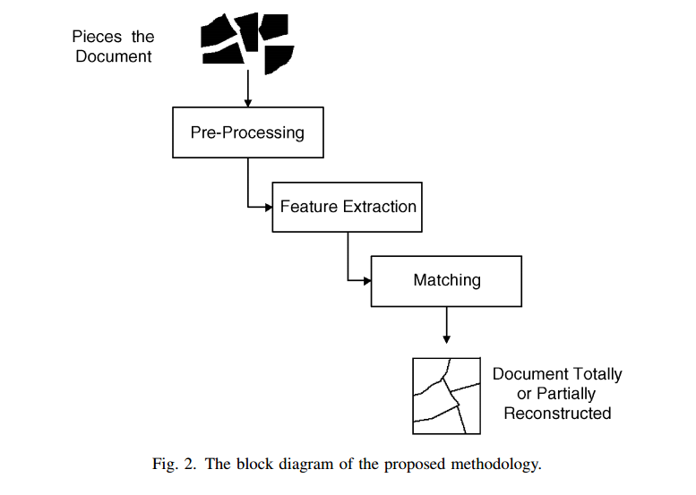
Fundamental Steps

Slide 7
Employed Technique
Our main source code is organized in several layers where the input images are processed one by one and passed on from one layer to the other for further processing.
Pre-processing:
We have no previous information about the nature of input images whether they are colored, black and white, pieces of a newspaper or entirely a painting. Pre processing thus become an important part of our algorithm. We first load the input image into GRAYSCALE mode and apply thresholding to obtain a binary image. This binary image is then processed by CannyDetector which takes out the largest closed contour (our actual image) and discards all the other contours.

Slide 8
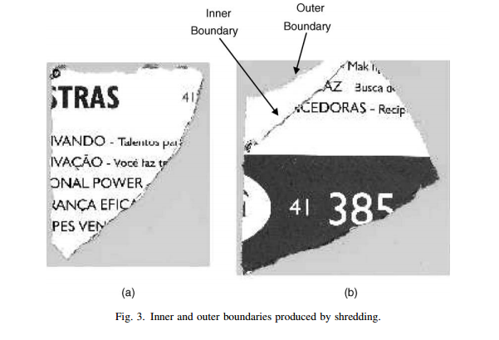
Corner Detection:
The contour obtained from previous step is approximated to a nearest polynomial by a particular threshold determined with trial and error technique. This would return us an array of small number of corners.

Slide 9
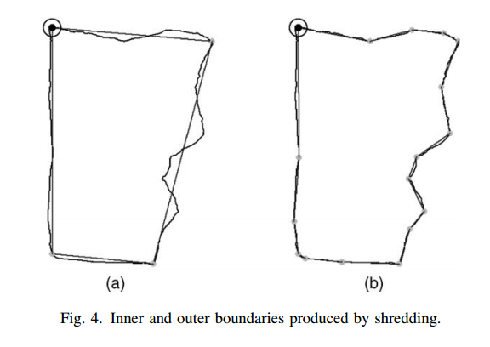
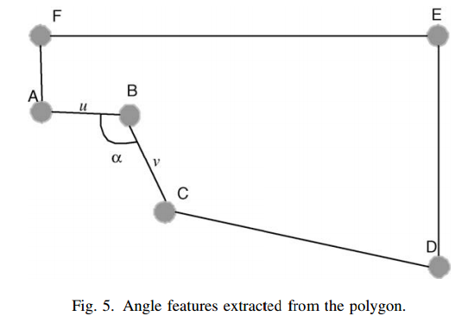
Employed Technique

Slide 10
System Requirements
The program was tested on Linux based platform running Ubuntu 12.04 LTS. The program must meet following requirements to run successfully:
OpenCV v2.4.0 or higher
Java Runtime Environment v7.0.25u or higher
The hardware must have at least:
1.5 Ghz Dual Core or latest processor.
100 MB of free Hard Disk Space.

Slide 11
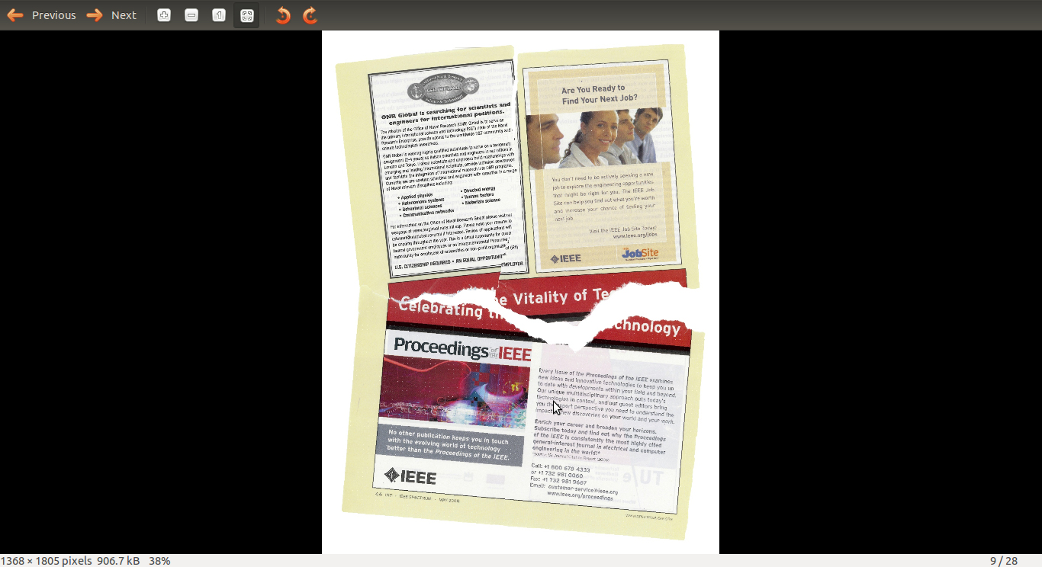
OUTPUT

Slide 12
Appendix
Unlike the tradition of previous years, we have decided to release all the source code along with the problem statement and documentation in Public Domain and will be hosted on https://github.com.
We also encourage Open source development and the idea of use of Version Control Systems in their active collaborative development.
We thank the problem setters, Hall members, our friends and fellow scientific community for providing us with constant encouragement and knowledge to learn and explore.

Slide 13
THANK YOU

